Slide 1
we don’t type for a living
plural programming practices
for productivity and profit
@jonfazzaro

Slide 2

It is counter intuitive, but 2 people working at a single computer will add as much functionality as two working separately except that it will be much higher in quality. With increased quality comes big savings later in the project.
Notes:
They buried the lede here
What do you say after reading that?
Quality is good.
Savings are nice.
But what do the people paying for the nerds hear?

Slide 3
Notes:
Eat your vegetables
This doesn’t connect
Here’s the real problem.
“What else does it do?”

Slide 4
Notes:
Software development is SLOW
You will be up against this problem for your whole career as a dev

Slide 5
Pair programming makes the heart-grindingly slow process of software development go faster.
Notes:
Here’s my rewrite.
Two nerds, one keyboard
How does this make us faster?
Another question.

Slide 6

Notes:
Is this cat writing code?
No, he never stops typing
We don’t type for a living

Slide 7
Notes:
(story of the chalk x invoice)
Great story
Illustrates
manual work vs knowledge work
thinking

Slide 8
manual work (time * people = value)
Notes:
folding laundry, doing dishes, factory line
linear and predictable

Slide 9
knowledge work (time * people = maybe)
Notes:
This is knowledge work
Unpredictable, reacts non-linearly to adjustments of time and resources.
Setbacks
This is because in knowledge work, we are forever slipping backward each time we move forward.
Trial and error
A creative process

Slide 10
Notes:
So, back to this guy.
The slowness of knowledge work.
The slowness of knowledge work is an illusion
based on our expectations of manual work.
We completely discount the cost of the creative, generative work inherent in it,
And we expect to be able treat it like linear task work.
This inevitably disappoints everyone.
So, how do we make this faster?
We have to think about going faster differently.

Slide 11
Notes:
A Wrinkle in Time?
Not the movie
Traditionally, we think of the shortest distance between two points as a straight line. To get to point B, we just have to slog it out.

Slide 12
Notes:
Tesseract
Folds time and space
We can speed up the non-linearity of Knowledge work with a non-linear approach to the work.

Slide 13
Notes:
But this doesn’t just happen when we put two developers together.
There’s are some dos and don’ts here.
pairing is not
two machines
one watches
one checks reddit
Every team is different,
Every pair is different.
But here are two essential practices to
ensure that you and your team
get what you pay for with pairing and mobbing.

Slide 14
1. strong pairing
Notes:
A new way to split the work.
We know from Lean Manufacturing that to make any system go faster, we have to first identify its bottleneck.
The bottleneck in Knowledge Work is
our singular locus of attention
in search of the next right right idea.
By adding more brains to the same problem at the same time,
we are adding resources to the bottleneck.
we multiply the points of attention.
we multiply the ideas generated,
and we multiply our chances of finding the right next thing to try.

Slide 15
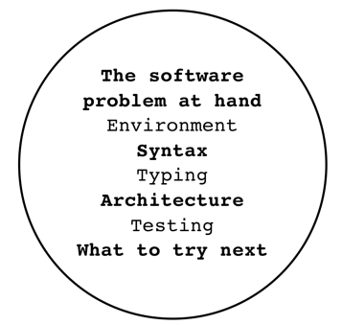
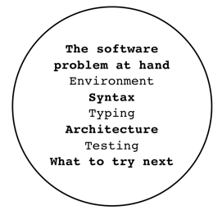

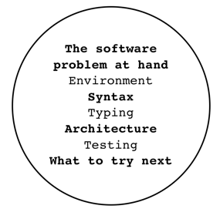
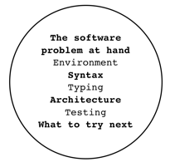
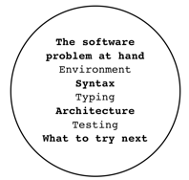
Notes:
The traditional approach.
We add more brains to the problem.
But then we give them each their own programming task!
division of labor.
Frederick Taylor was right about one thing--in order to be efficient in solving a problem, we have to first decompose it.
We have to break it down.
But there’s a problem here. Do you see it?

Slide 16
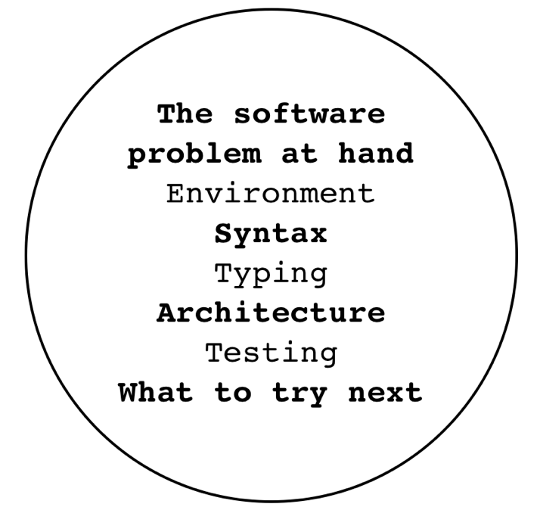
Notes:
Let’s take a closer look.
What is it that we do when we develop software?
This is just what happens when coding.
Not to mention the other components of software development like requirements, QA, and operations.
There’s a lot going on all at once.
How much of this resource—this brain—is really able to focus on that bottleneck?
Could we break this down further?

Slide 17

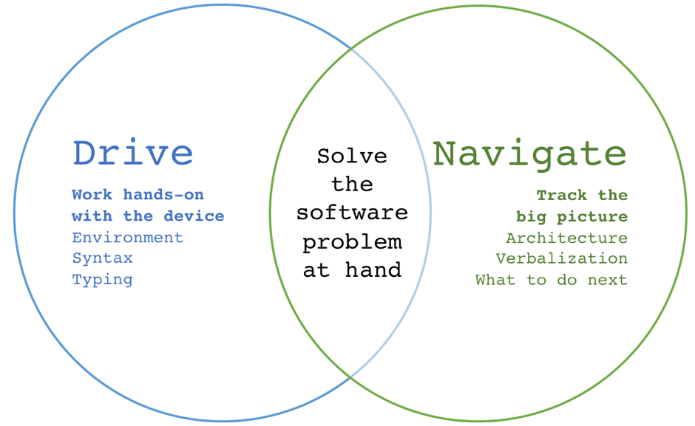
Notes:
This is where pairing and mobbing come in.
We split the job between two or more people.
This lightens each person’s cognitive load
And the pair can move quickly through a complex task.

Slide 18
project
Software development timeline
Notes:
As far as what you do want to do,
there is one sentence I keep coming back to to articulate it.

Slide 19
for an idea to go from your head into the computer, it MUST go through someone else's hands.
Llewelyn Falco
Agile Coach
Awesome Name-haver
Notes:
Driver and navigator

Slide 21
2. strong breaking
Notes:
Attention is the resource to manage for Knowledge Work.
We can’t manage attention directly, but can care for it through managing our time.
This problem multiplies in importance when programming in a group.
One of the most counterproductive states a team can be in is pairing/mobbing while one or more in the group are tired, and their attention is flagging.

Slide 22

Notes:
An effective way to prevent this is to Take a break before you need a break.
As a group.
This sounds easy. But it is not.
Use a timer.
Preferably one that BREAKS your flow.

Slide 23
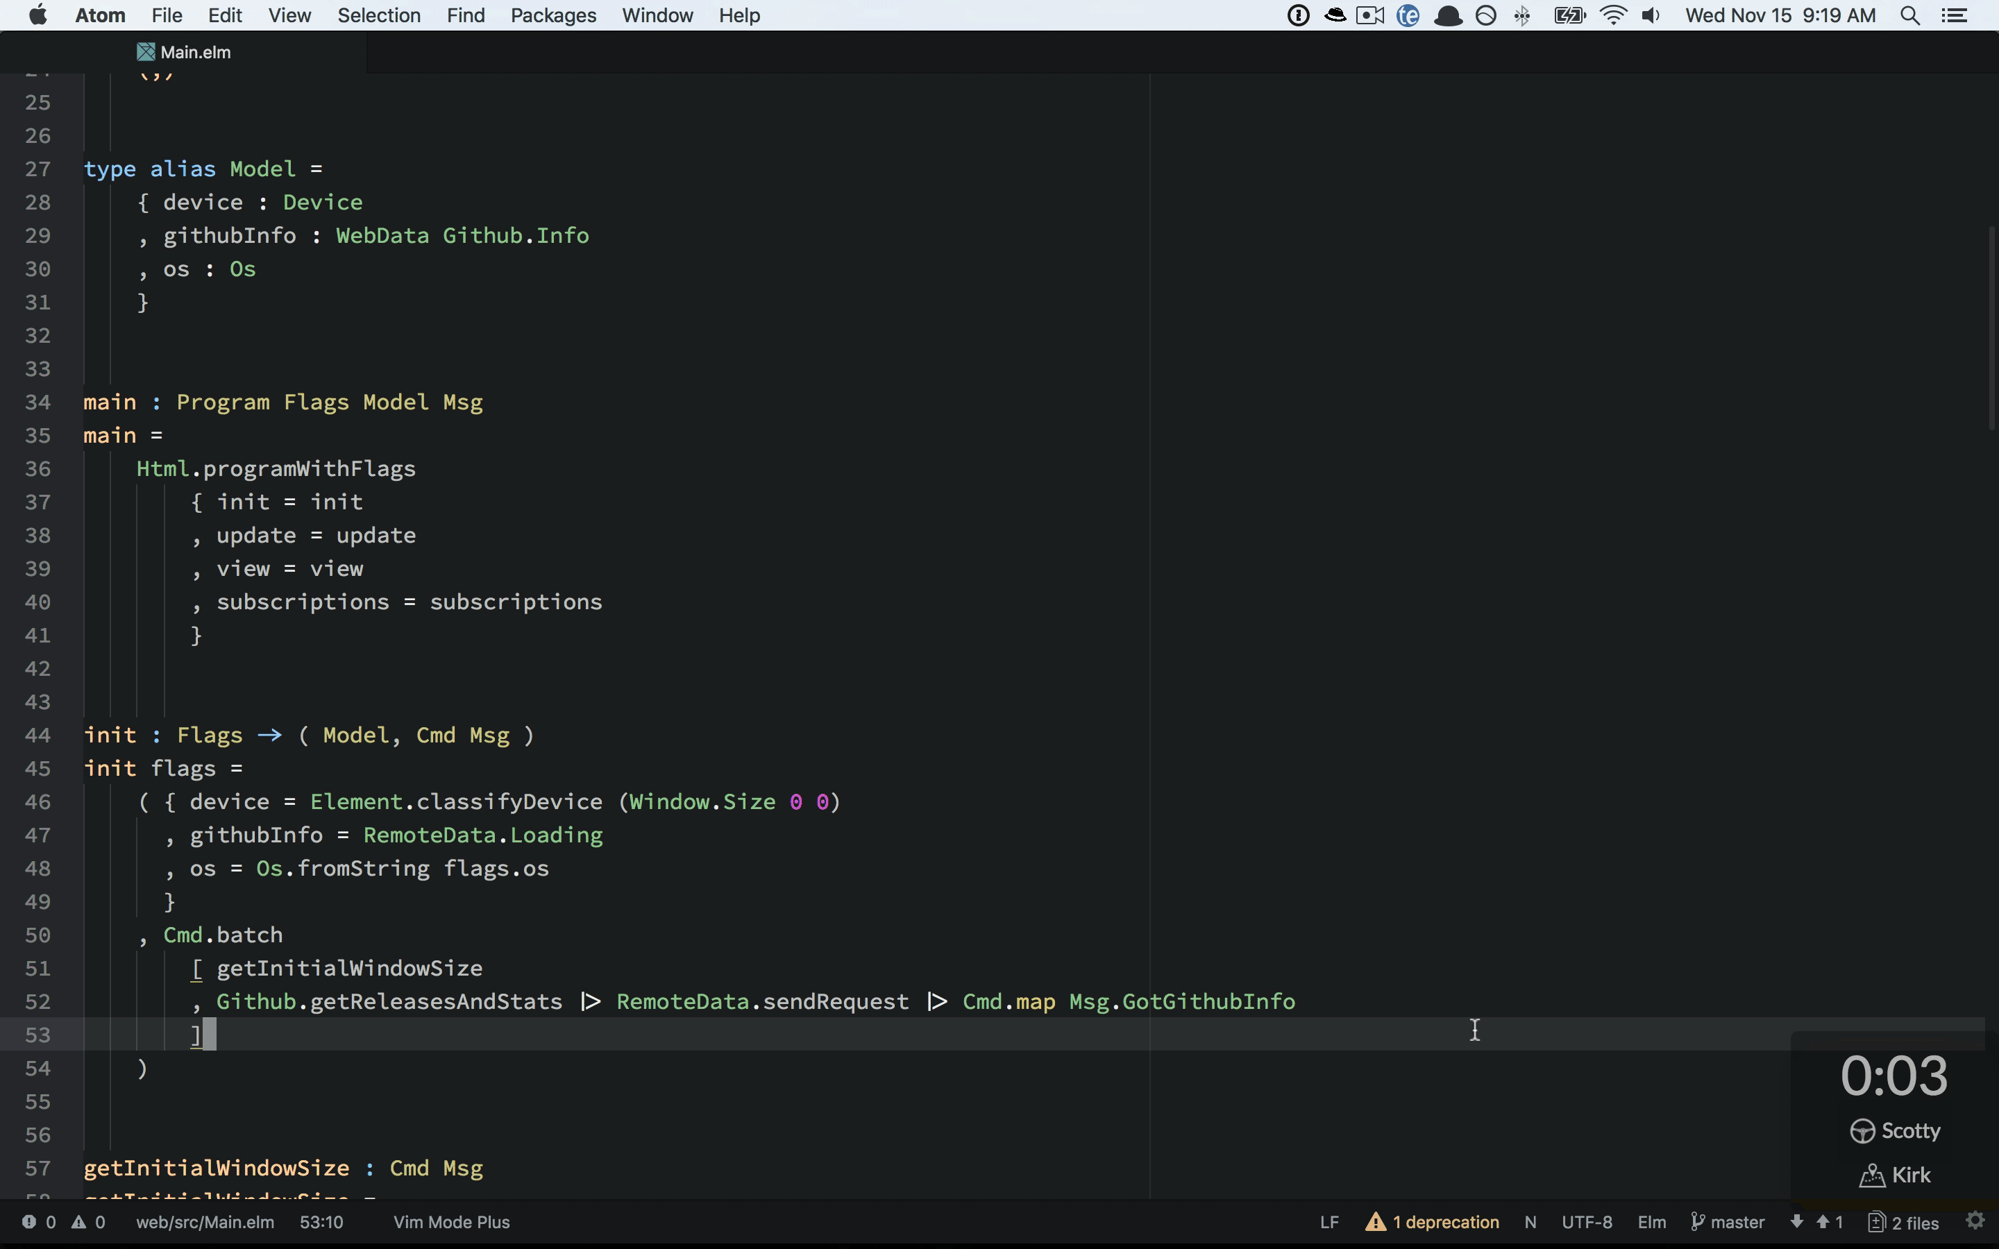
Notes:
Mobster is my current favorite.
Yes, I said to BREAK your flow.
But Csikszentmihalyi! Flow state!

Slide 24
focus
Notes:
I read that 20 minutes?
Don’t we need focus to code?
Yes, sometimes

Slide 25
Notes:
Don’t we need to focus for long periods of time to do this work?
Don’t nerds take up to 20 minutes to recover from an interruption?
Don’t we need that DEEP FOCUS to write code?
Yes, sometimes.
But remember, when we solo, we’re trying to juggle all of the aspects of this job at once.
This of course would require intense concentration, and would probably fall to pieces at an interruption.
More often than not, what I see happen as a side-effect of this difficult balancing act is that one or more aspects of the work suffer from even trying.

Slide 26
The human eye has an almost infinite capacity for not seeing what it does not want to see.... Programmers, if left to their own devices, will ignore the most glaring errors in their output—errors that anyone else can see in an instant.
Gerald Weinberg
The Psychology of
Computer Programming
Notes:
To this point…

Slide 27
focus tunnel vision
Notes:
And what you may call focus, Gerry and I call tunnel vision.
So yeah, when you are heads-down and focused,
without interruption,
you could write the wrong code really fast.

Slide 28
focus tunnel vision
“clever”-ness
complexity
bugs
debt
rework
Notes:
This results in
cleverness
complexity
bugs
technical debt
rework
Things that hemorrhage your project’s budget.
But are they more costly than two people coding together at the same computer?

Slide 29
cost
Notes:
Let’s talk about cost.
“Getting done sooner doesn’t help me if this breaks my budget in half, we’re paying devs by the hour!”
Again, this assumes a linear relationship between fingers on keyboards, hours, and features delivered.
Focus on division of labor
But we don’t deliver “tasks”.
We deliver Features!
What about the integration?
As it happens, this aspect of managing project work is so often missed,
that the missing it itself has a name:

Slide 30
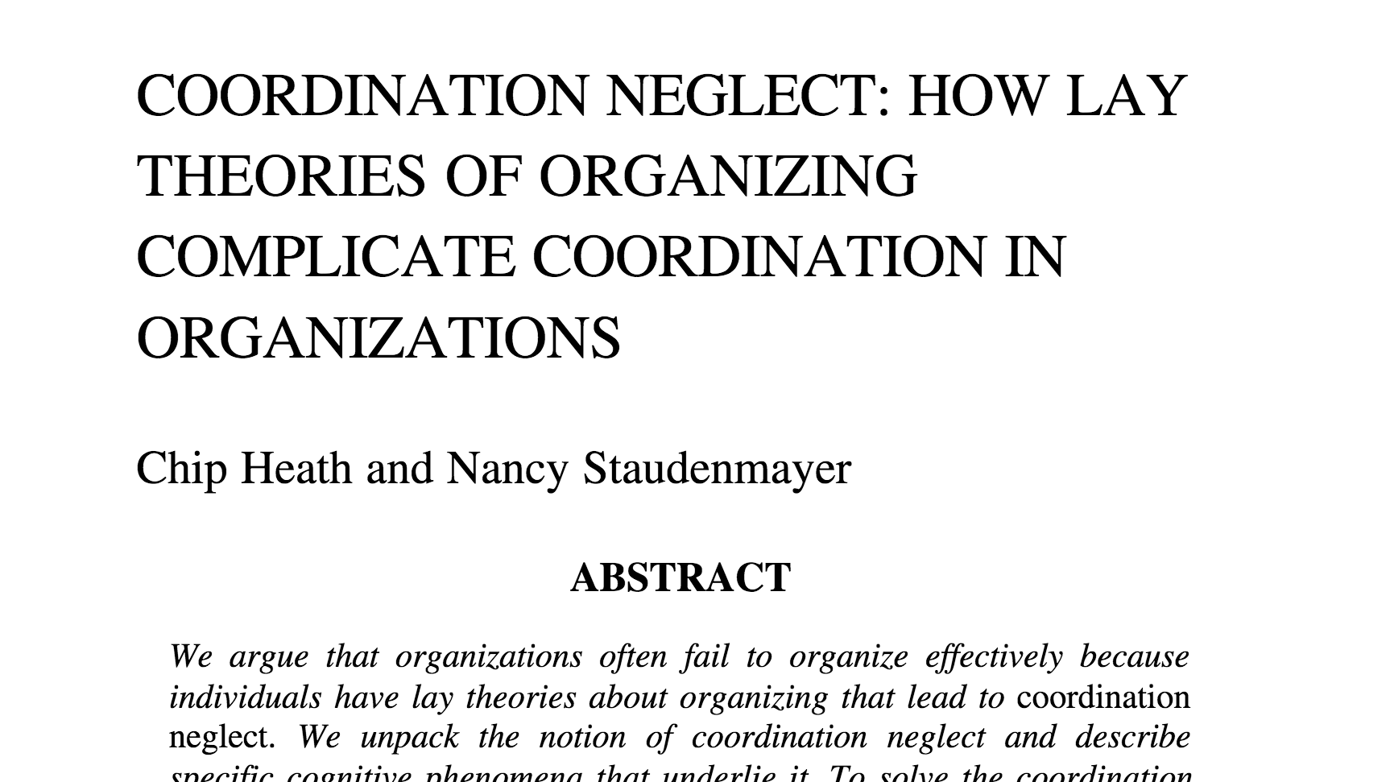
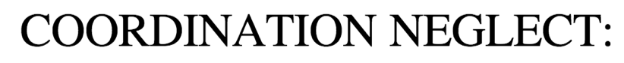
Notes:
In other words, we focus and obsess over the division and individual execution of the work
While totally blowing off how difficult and expensive it will be to integrate and deliver the valuable whole afterward.
So while we are clutching our pearls over the idea of more than one nerd at a keyboard,
we turn a blind eye to the time spent on
merges, deployments, code reviews,
back-and-forth with QA, etc.
dribbling every task out to a slow, painful, expensive death.

Slide 31
continuous integration and
delivery
Notes:
DevOps/Continuous practices are an attempt to directly take on coordination neglect
On a team of solo developers, this is an uphill battle.

Slide 32
simultaneous integration and
delivery
Notes:
Pairs, however, have a much easier time.
Mobs have it licked.
Speaking of finishing things.

Slide 33
done
Notes:
Let’s talk about this word.
What does this word mean?
Ask everyone on your team to write down an answer.
Every one of them will probably be different.
But what if you combined those different answers?
Together, they are probably right
Solo dev:
Rework
Bugs
Side effects
Missed scenarios
Technical debt
SLOW
drastically reduced by plural dev
Gives us a living definition of done

Slide 34
If you want something marked done, give it to a solo developer.

Slide 35
If you want something to get done, give it to a pair.

Slide 36
If you want something to stay done, give it to a mob.

Slide 37
If you want to go fast, don’t go alone.

Slide 38
we don’t type for a living
plural programming practices
for productivity and profit
@jonfazzaro
Notes:
Thank you!

